Slide 1


Supply Chain Management System Project

Slide 2
Project Overview
Goal
Results
Data source and scope
Results
Problem
Key Insights
Methodology
Conclusion

Slide 3
Goal
Develop a system to analyze a global supply chain on a real-time basis and provide visibility into supplier and order performance, cost efficiency, and distribution patterns.

Slide 4
Data Source and Scope
Total Orders: 47
Raw Materials: 13
Suppliers: 10
Regions Covered: East Asia, Europe, Africa, Americas
*Included Data:**
Order History
Supplier Details
Inventory Levels
Transportation and Pricing Information
Tools: Power BI, DAX, Excel, SQL

Slide 5
Problem
Organizations lack real-time visibility into global supply chain operations, impacting cost control, supplier performance tracking, and distribution efficiency. This project addresses these gaps using Power BI to deliver interactive insights into orders, materials, suppliers, and logistics. The system is designed for supply chain managers & procurement teams.

Slide 6
Methodology
Data cleaned in Excel, queried using SQL
Created views in MySQL to:
Track lead times by supplier
Identify reorder triggers
Calculate average unit cost per region etc
Created measures in DAX
Build an interactive dashboard in Power BI
Applied filters by suppliers, orders, raw materials, transport mode,
and regions.

Slide 7
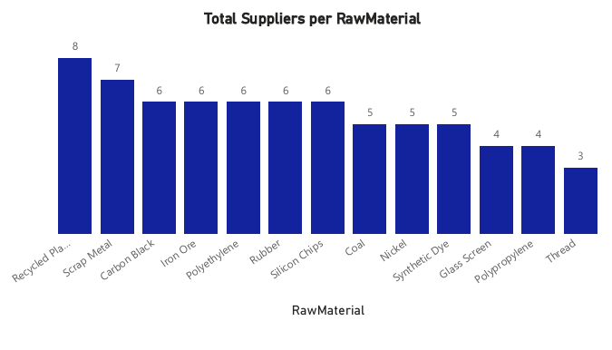
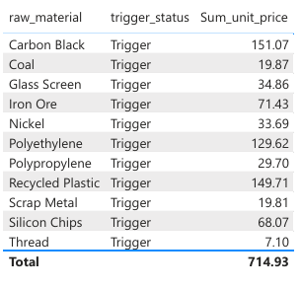
Results

Slide 8
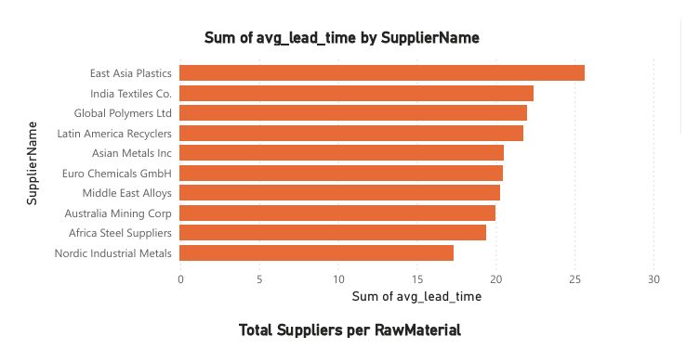
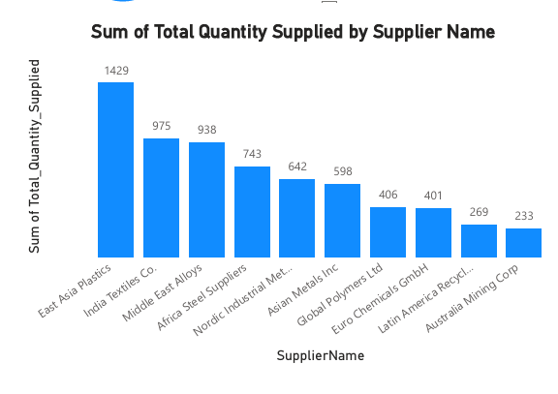
Results

Slide 9
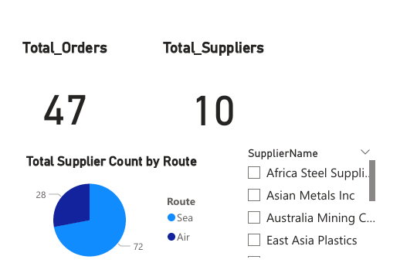
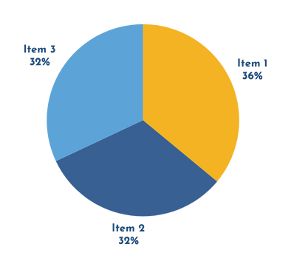
Key Insights
Power BI Dashboard Insights
Top Suppliers:
East Asia Plastics and India Textiles Co.
Most Supplied Materials:
Recycled Plastic and Scrap Metal
Transport Trends:
Sea routes = 72% of logistics → longer lead times
Asia suppliers = highest average lead times

Slide 10
Conclusion
This SQL and Power BI solution successfully enhances global supply chain visibility, enabling data-driven decisions on cost efficiency, supplier performance, and logistics optimization- supporting smarter procurement and improved operational responsiveness.

Slide 11

THANK YOU
Presented by: Anne Musau

